Slide 1
Introduction to Problem Solving, Selection Control Statements & Logical Operators
Java™ How to Program, 10/e Late Objects Version

Slide 2
References & Reading
The content is mainly selected (sometimes modified) from the original slides provided by the authors of the textbook
Readings
Chapter 2: Introduction to Java Applications; Input/Output and Operators
Chapter 3: Control Statements: Part I; Assignment, ++ and – Operators
Chapter 4: Control Statements: Part 2; Logical Operators

Slide 3
Outline
3.1 Introduction
3.2 Algorithms
3.3 Pseudocode
3.4 Control Structures
3.5 if Single-Selection Statement
2.8 Decision Making: Equality and Relational Operators
3.6 if…else Double-Selection Statement
4.6 switch Multiple-Selection Statement
4.8 Logical Operators

Slide 4
3.1 Introduction
Before writing a program to solve a problem, have a thorough understanding of the problem and a carefully planned approach to solving it.
Understand the available building blocks and employ proven program-construction techniques.
Any computing problem can be solved by executing a series of actions in a specific order.

Slide 5
3.2 Algorithms
An algorithm is a procedure for solving a problem in terms of
the actions to execute and
the order in which these actions execute
The “rise-and-shine algorithm” followed by one executive for getting out of bed and going to work:
(1) Get out of bed; (2) take off pajamas; (3) take a shower; (4) get dressed; (5) eat breakfast; (6) carpool to work.
Suppose that the same steps are performed in a slightly different order:
(1) Get out of bed; (2) take off pajamas; (3) get dressed; (4) take a shower; (5) eat breakfast; (6) carpool to work.
Specifying the order in which statements (actions) execute in a program is called program control.

Slide 6
3.3 Pseudocode
Pseudocode is an informal language that helps you develop algorithms without having to worry about the strict details of the programming language (Java) syntax.
Particularly useful for developing algorithms that will be converted to structured portions of Java programs.
Similar to everyday English.
Helps you “think out” a program before attempting to write it in a programming language, such as Java.
You can type pseudocode conveniently, using any text-editor program.
Carefully prepared pseudocode can easily be converted to a corresponding Java program.
Pseudocode normally describes only statements representing the actions that occur after you convert a program from pseudocode to Java and the program is run on a computer.
e.g., input, output or calculations.

Slide 7
3.4 Control Structures
Sequential execution: Statements in a program execute one after the other in the order in which they are written.
Transfer of control: Various Java statements, enable you to specify that the next statement to execute is not necessarily the next one in sequence.
Bohm and Jacopini
Demonstrated that programs can be written in terms of only three control structures—the sequence structure, the selection structure and the repetition structure.
We refer to the control structures in the terminology of Java as “control statements.”

Slide 8
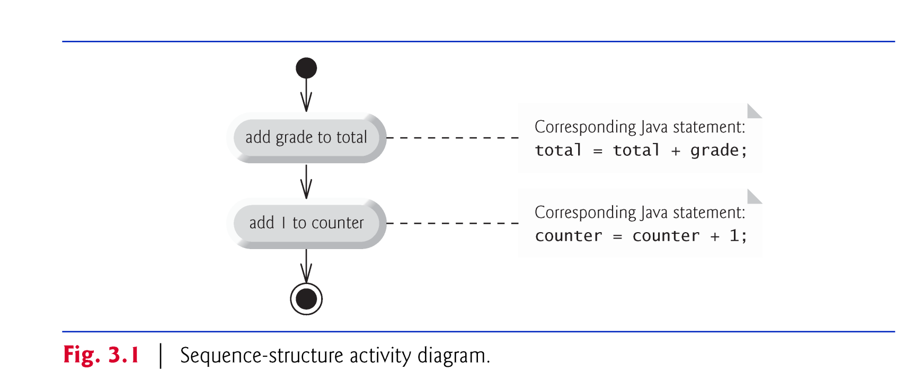
3.4 Control Structures (Cont.)
Sequence structure
Unless directed otherwise, the computer executes Java statements one after the other in the order in which they’re written.
Java lets you have as many actions as you want in a sequence structure.

Slide 9
3.4 Control Structures (Cont.)
UML activity diagram
Models the workflow (also called the activity) of a portion of a software system.
May include a portion of an algorithm.
Help you develop and represent algorithms.
Clearly show how control structures operate.
Composed of symbols
Symbols connected by transition arrows, which represent the flow of the activity—the order in which the actions should occur.
More information on the UML
see the optional case study (Chapters 33–34)
visit www.uml.org

Slide 10
3.4 Control Structures (Cont.)
Action-state symbols (rectangles with their left and right sides replaced with outward arcs): contain an action expression that specifies a particular action to perform
Arrows represent transitions (order in which the actions represented by the action states occur).
Diamonds indicates that a decision is to be made.
Solid circle at the top represents the initial state—the beginning of the workflow before the program performs the modeled actions.
Solid circle surrounded by a hollow circle at the bottom represents the final state—the end of the workflow after the program performs its actions.

Slide 11
3.4 Control Structures (Cont.)
Three types of selection statements.
if statement:
Performs an action, if a condition is true; skips it, if false.
Single-selection statement—selects or ignores a single action (or group of actions).
if…else statement:
Performs an action if a condition is true and performs a different action if the condition is false.
Double-selection statement—selects between two different actions (or groups of actions).
switch statement
Performs one of several actions, based on the value of an expression.
Multiple-selection statement—selects among many different actions (or groups of actions).

Slide 12
3.4 Control Structures (Cont.)
Three repetition statements (also called iteration statements or looping statements)
Perform statements repeatedly while a loop-continuation condition remains true.
while and for statements perform the action(s) in their bodies zero or more times
if the loop-continuation condition is initially false, the body will not execute.
The do…while statement performs the action(s) in its body one or more times.
if, else, switch, while, do and for are keywords.
Appendix C: Complete list of Java keywords.

Slide 13
3.5 if Single-Selection Statement
if selection statement
Allows a program to make a decision based on a condition’s value.
An if statement always begins with keyword if, followed by a condition in parentheses.
Condition
An expression that can be true or false.
Pseudocode
If student’s grade is greater than or equal to 60 Print “Passed”
The preceding pseudocode If in Java:
if ( studentGrade >= 60 ) System.out.println( "Passed" );
Indentation is optional, but recommended
Emphasizes the inherent structure of structured programs
Notes:
If the condition is false, the Print statement is ignored, and the next pseudocode statement in order is performed.

Slide 14
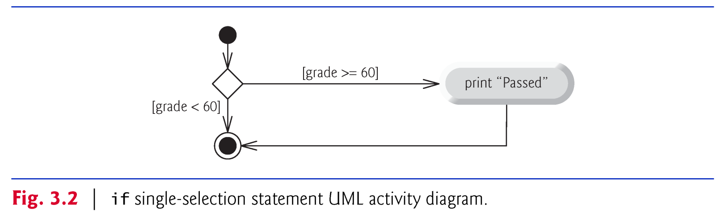
3.5 if Single-Selection Statement (Cont.)
if statement UML activity diagram.
Diamond, or decision symbol, indicates that a decision is to be made.
Workflow continues along a path determined by the symbol’s guard conditions, which can be true or false.
Each transition arrow emerging from a decision symbol has a guard condition (in square brackets next to the arrow).
If a guard condition is true, the workflow enters the action state to which the transition arrow points.

Slide 15
2.8 Decision Making: Equality and Relational Operators
Equality operators (== and !=)
Relational operators (>, <, >= and <=)
Both equality operators have the same level of precedence, which is lower than that of the relational operators.
The equality operators associate from left to right.
The relational operators all have the same level of precedence and also associate from left to right.

Slide 16
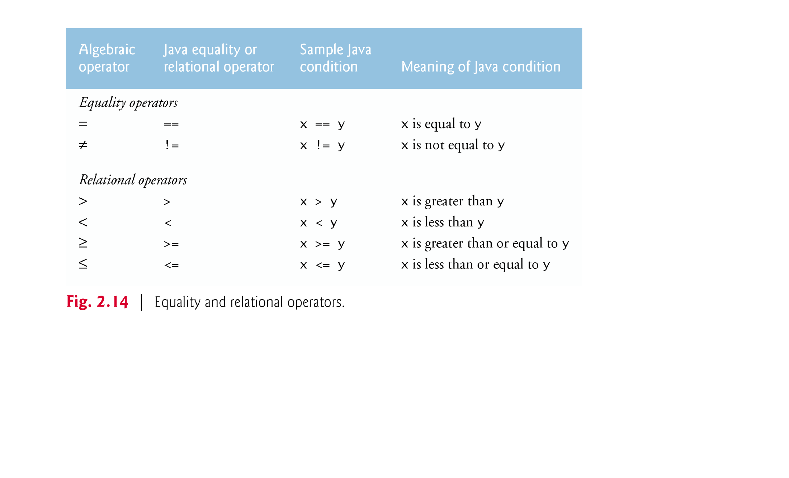
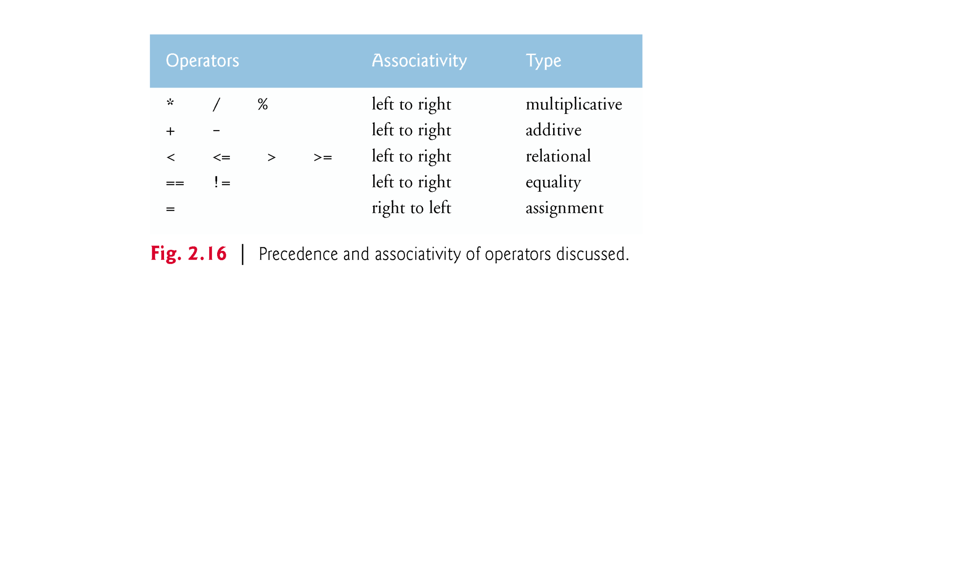

Slide 17
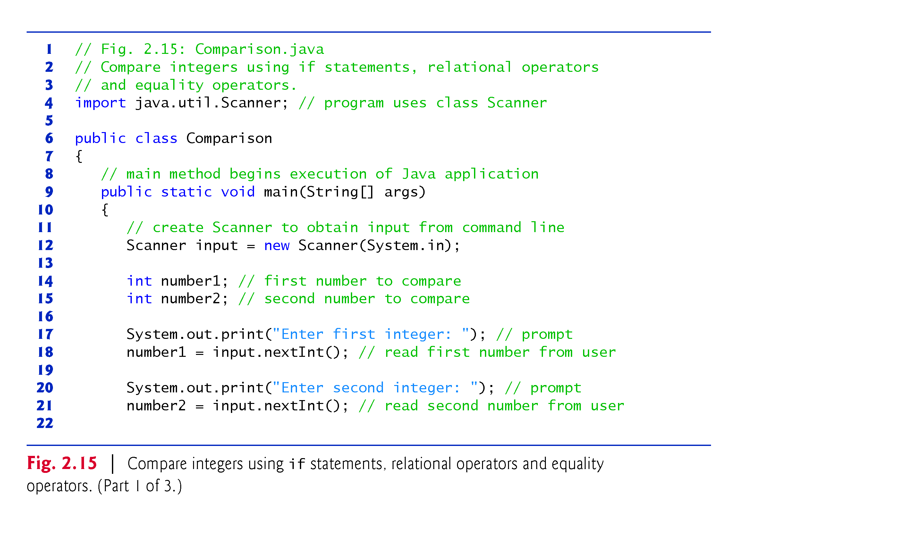

Slide 18
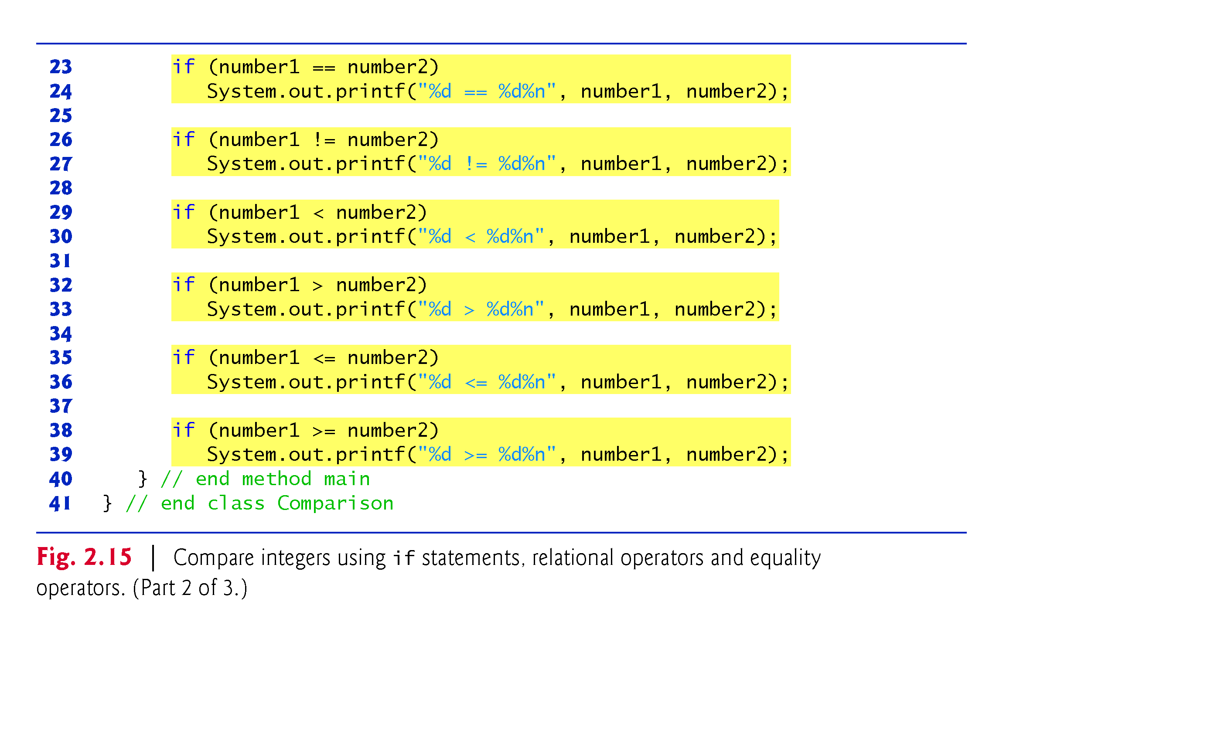

Slide 19
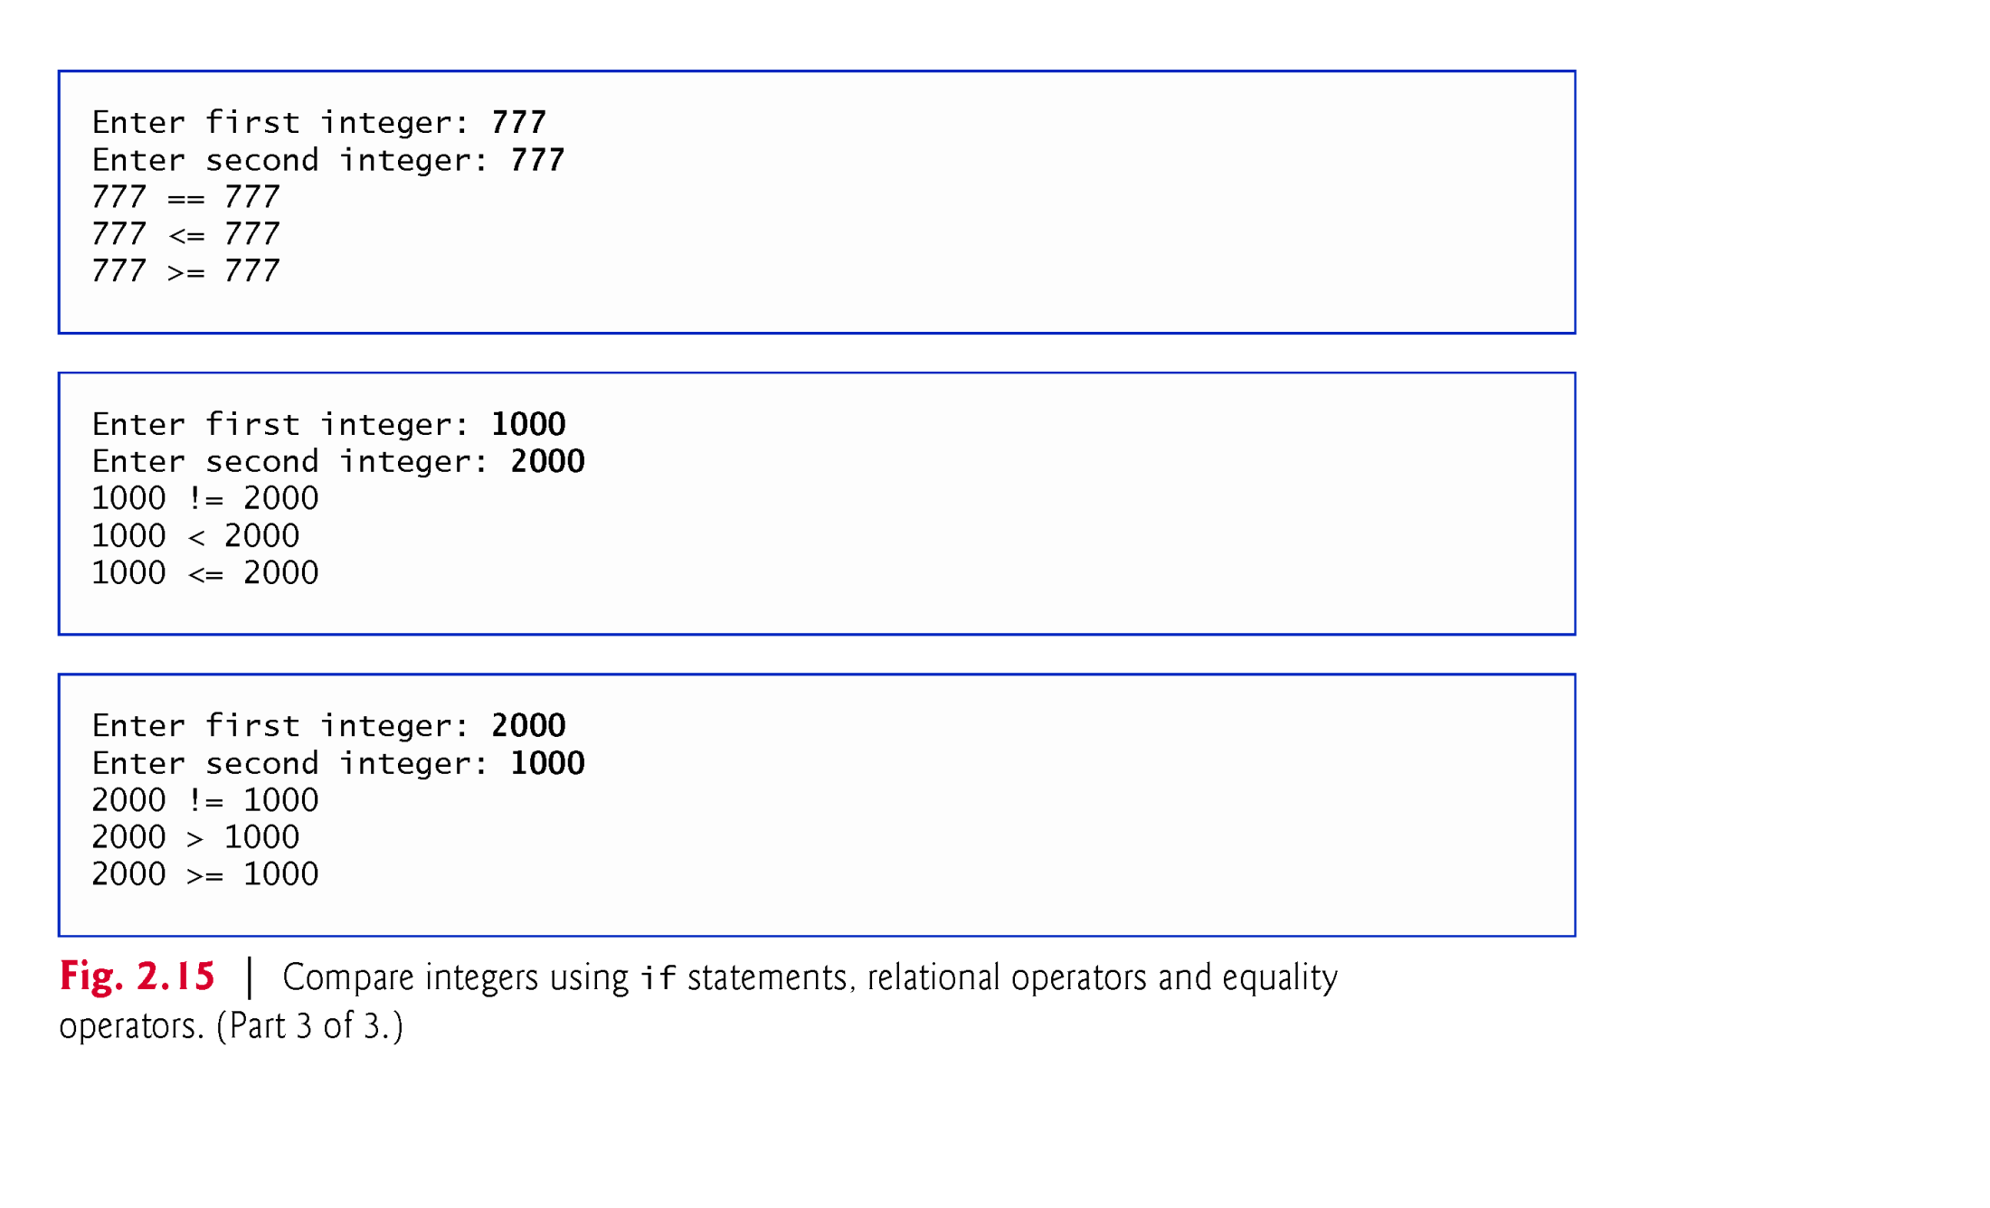

Slide 20
2.8 Decision Making: Equality and Relational Operators (Cont.)
An if statement expects one statement in its body,
if ( studentGrade >= 60 ) System.out.println( "Passed" );
but may contain multiple statements if they are enclosed in a set of braces ({}).
if ( studentGrade >= 60 )
{
System.out.println( "Passed" );
System.out.println( “Congratulations" );
}
Note that there is no semicolon (;) at the end of the first line of each if statement.

Slide 21
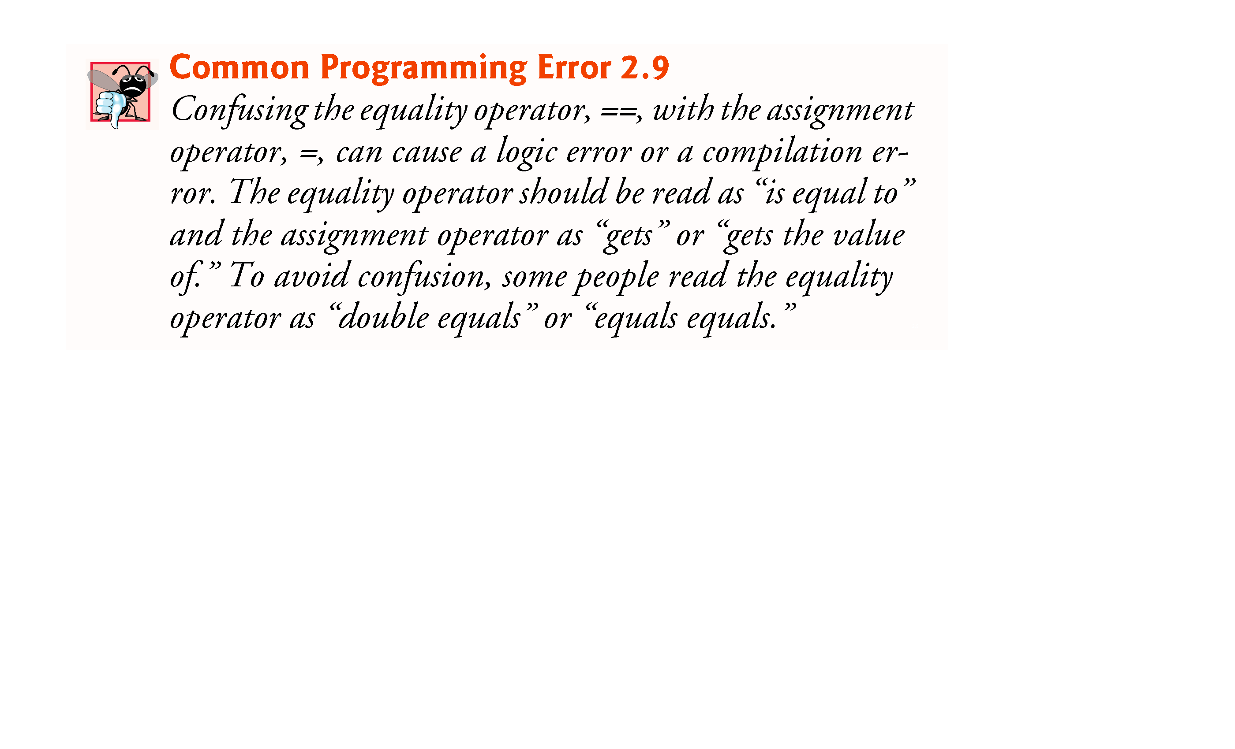

Slide 22
3.6 if…else Double-Selection Statement
if…else double-selection statement—specify an action to perform when the condition is true and another action when the condition is false.
Pseudocode
If student’s grade is greater than or equal to 60 Print “Passed” Else Print “Failed”
The preceding If…Else pseudocode statement in Java:
if ( grade >= 60 ) System.out.println( "Passed" ); else System.out.println( "Failed" );
Note that the body of the else is also indented.

Slide 23
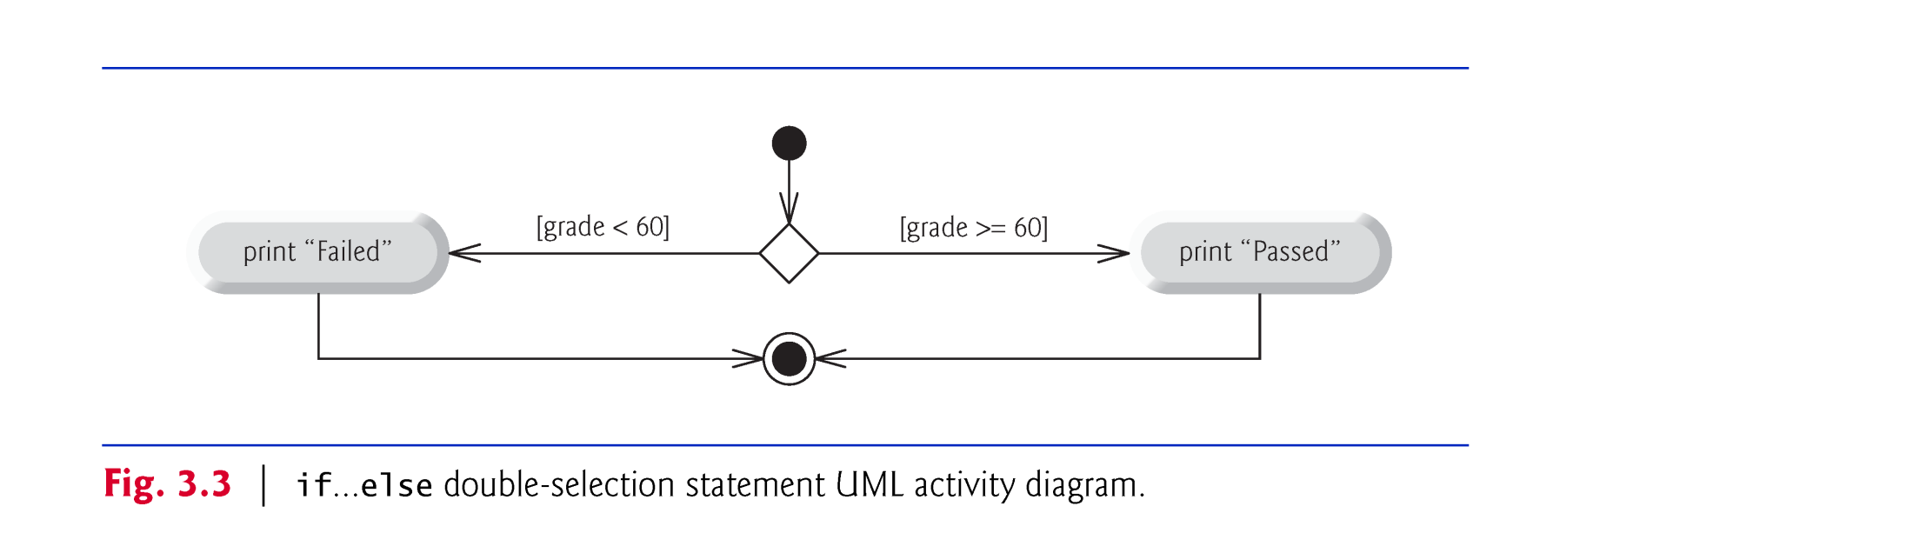
3.6 if…else Double-Selection Statement (Cont.)
if…else statement activity diagram.

Slide 24
3.6 if…else Double-Selection Statement (Cont.)
Can test multiple cases by placing if…else statements inside other if…else statements to create nested if…else statements.
Pseudocode:
If student’s grade is greater than or equal to 90
Print “A”
else
If student’s grade is greater than or equal to 80
Print “B”
else
If student’s grade is greater than or equal to 70
Print “C”
else
If student’s grade is greater than or equal to 60
Print “D”
else
Print “F”

Slide 25
3.6 if…else Double-Selection Statement (Cont.)
This pseudocode may be written in Java as
if (studentGrade >= 90) System.out.println("A"); else if (studentGrade >= 80) System.out.println("B"); else if (studentGrade >= 70) System.out.println("C"); else if (studentGrade >= 60) System.out.println("D"); else System.out.println("F");
If studentGrade >= 90, the first four conditions will be true, but only the statement in the if part of the first if…else statement will execute. After that, the else part of the “outermost” if…else statement is skipped.

Slide 26
3.6 if…else Double-Selection Statement (Cont.)
Most Java programmers prefer to write the preceding nested if…else statement as
if (studentGrade >= 90) System.out.println("A"); else if (studentGrade >= 80) System.out.println("B"); else if (studentGrade >= 70) System.out.println("C"); else if (studentGrade >= 60) System.out.println("D"); else System.out.println("F");
The two forms are identical except for the spacing and indentation, which the compiler ignores.

Slide 27
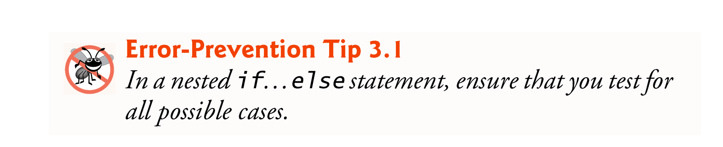
3.6 if…else Double-Selection Statement (Cont.)
The if statement normally expects only one statement in its body.
To include several statements in the body of an if (or the body of an else for an if…else statement), enclose the statements in braces.
Statements contained in a pair of braces form a block.
A block can be placed anywhere that a single statement can be placed.
Example: A block in the else part of an if…else statement:
if ( grade >= 60 ) System.out.println("Passed"); else { System.out.println("Failed"); System.out.println("You must take this course again."); }

Slide 28
3.6 if…else Double-Selection Statement (Cont.)
The Java compiler always associates an else with the immediately preceding if unless told to do otherwise by the placement of braces ({ and }).
Referred to as the dangling-else problem.
The following code is not what it appears:
if (x > 5) if (y > 5) System.out.println("x and y are > 5"); else System.out.println("x is <= 5");
The compiler actually interprets the statement as
if (x > 5) if (y > 5) System.out.println("x and y are > 5"); else System.out.println("x is <= 5");

Slide 29
3.6 if…else Double-Selection Statement (Cont.)
To force the nested if…else statement to execute as it was originally intended, we must write it as follows:
if (x > 5) { if (y > 5) System.out.println("x and y are > 5"); } else System.out.println("x is <= 5");
The braces indicate that the second if is in the body of the first and that the else is associated with the first if.
Exercises 3.27–3.28 investigate the dangling-else problem further.

Slide 30
3.6 if…else Double-Selection Statement (Cont.)
Syntax errors (e.g., when one brace in a block is left out of the program) are caught by the compiler.
A logic error (e.g., when both braces in a block are left out of the program) has its effect at execution time.
A fatal logic error causes a program to fail and terminate prematurely.
A nonfatal logic error allows a program to continue executing but causes it to produce incorrect results.

Slide 31
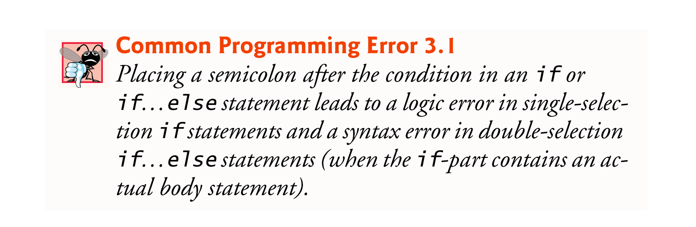
3.6 if…else Double-Selection Statement (Cont.)
The empty statement is represented by placing a semicolon (;) where a statement would normally be.

Slide 32

3.6 if…else Double-Selection Statement (Cont.)
Conditional operator (?:)—can be used in place of an if…else statement.
Ternary operator (takes three operands)
Operand to the left of the ? is a boolean expression—evaluates to a boolean value (true or false)
Second operand (between the ? and :) is the value if the boolean expression is true
Third operand (to the right of the :) is the value if the boolean expression evaluates to false.
Example:
System.out.println(studentGrade >= 60 ? "Passed" : "Failed");
Evaluates to the string "Passed" if the boolean expression studentGrade >= 60 is true and to the string "Failed" if it is false.

Slide 33
4.6 switch Multiple-Selection Statement
switch multiple-selection statement performs different actions based on the possible values of a constant integral expression of type byte, short, int or char.
As of Java SE 7, the expression may also be a String.

Slide 34
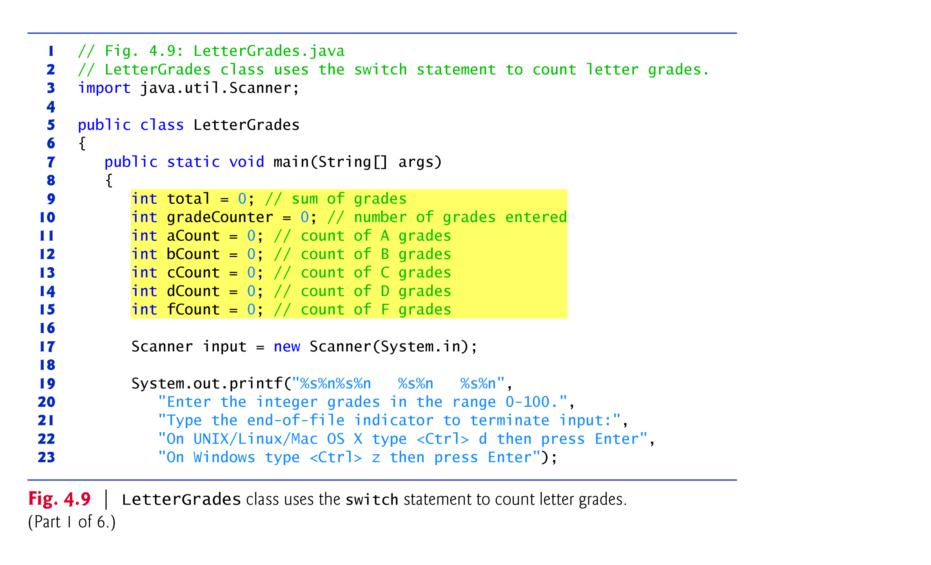
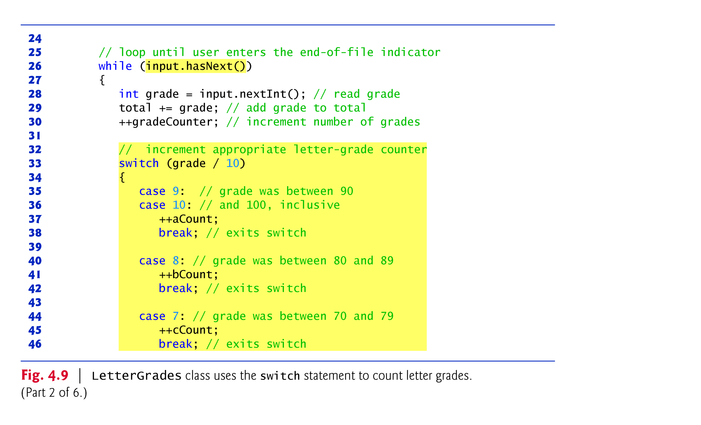
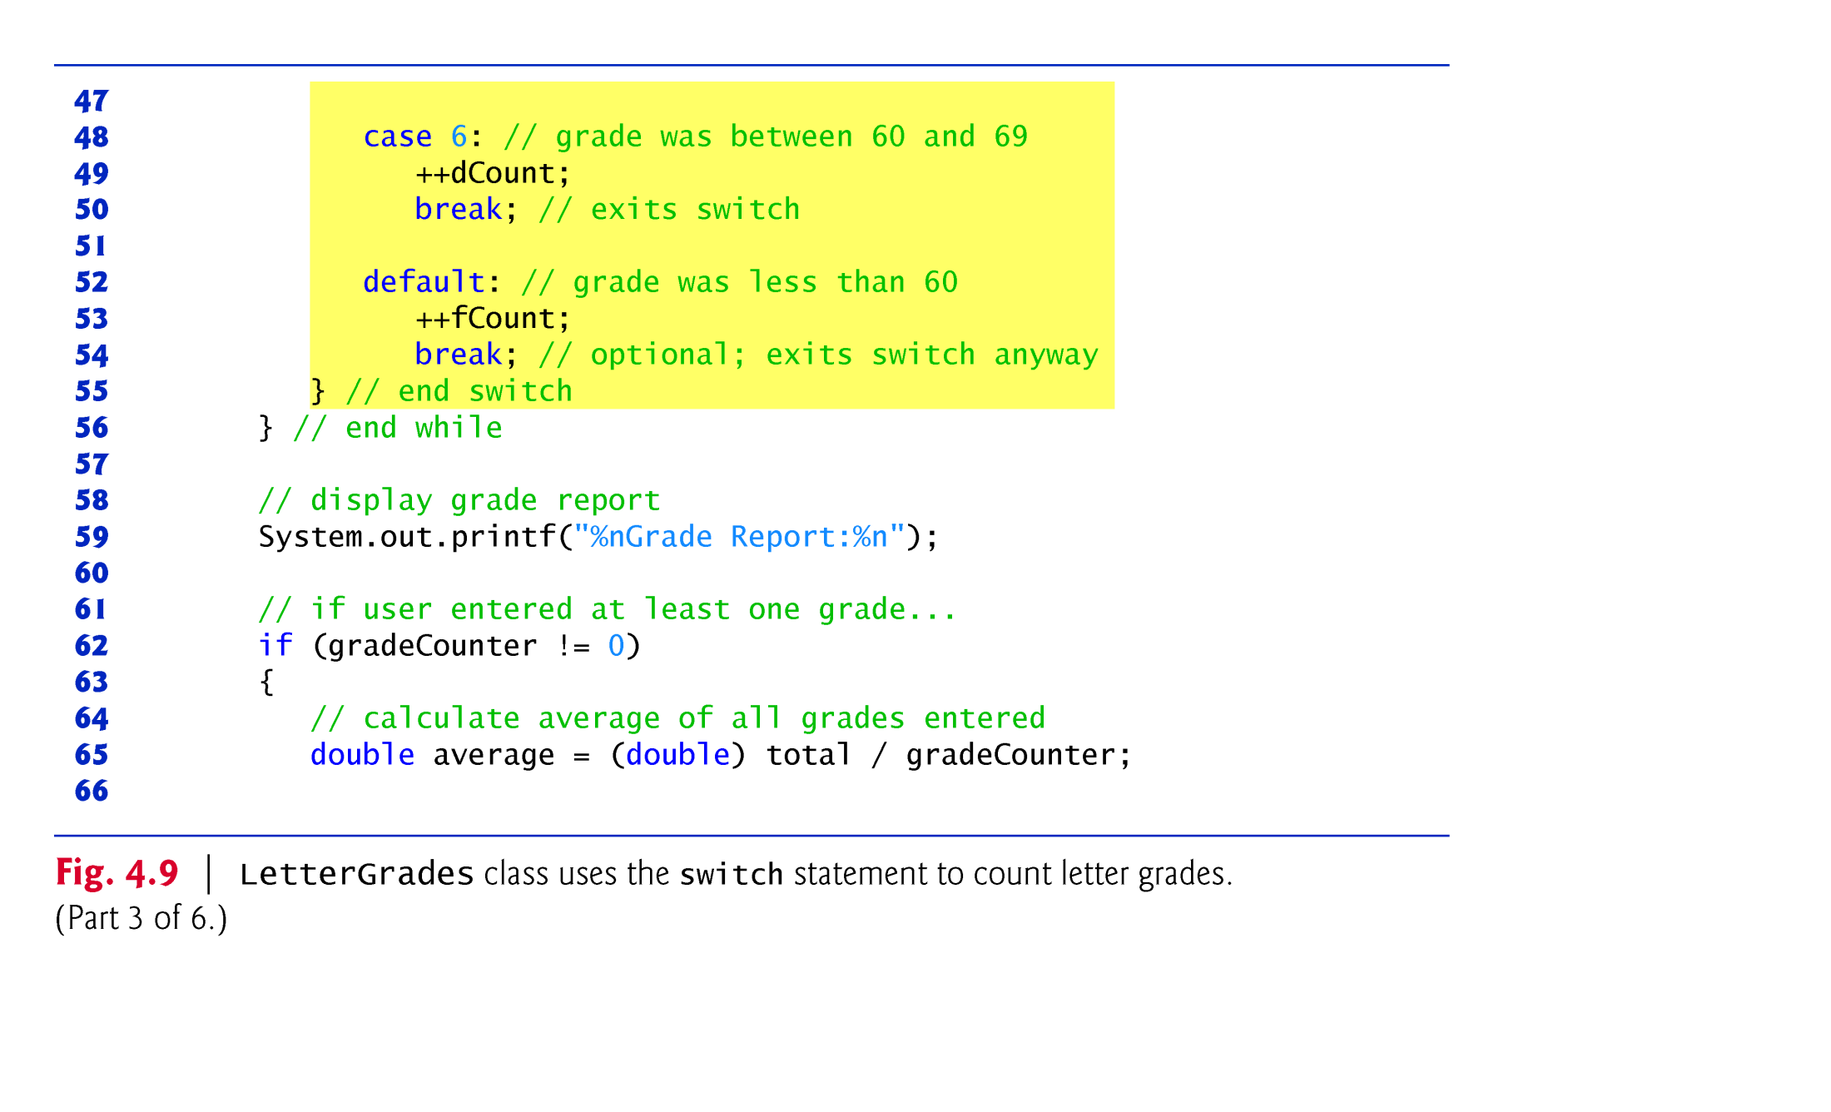
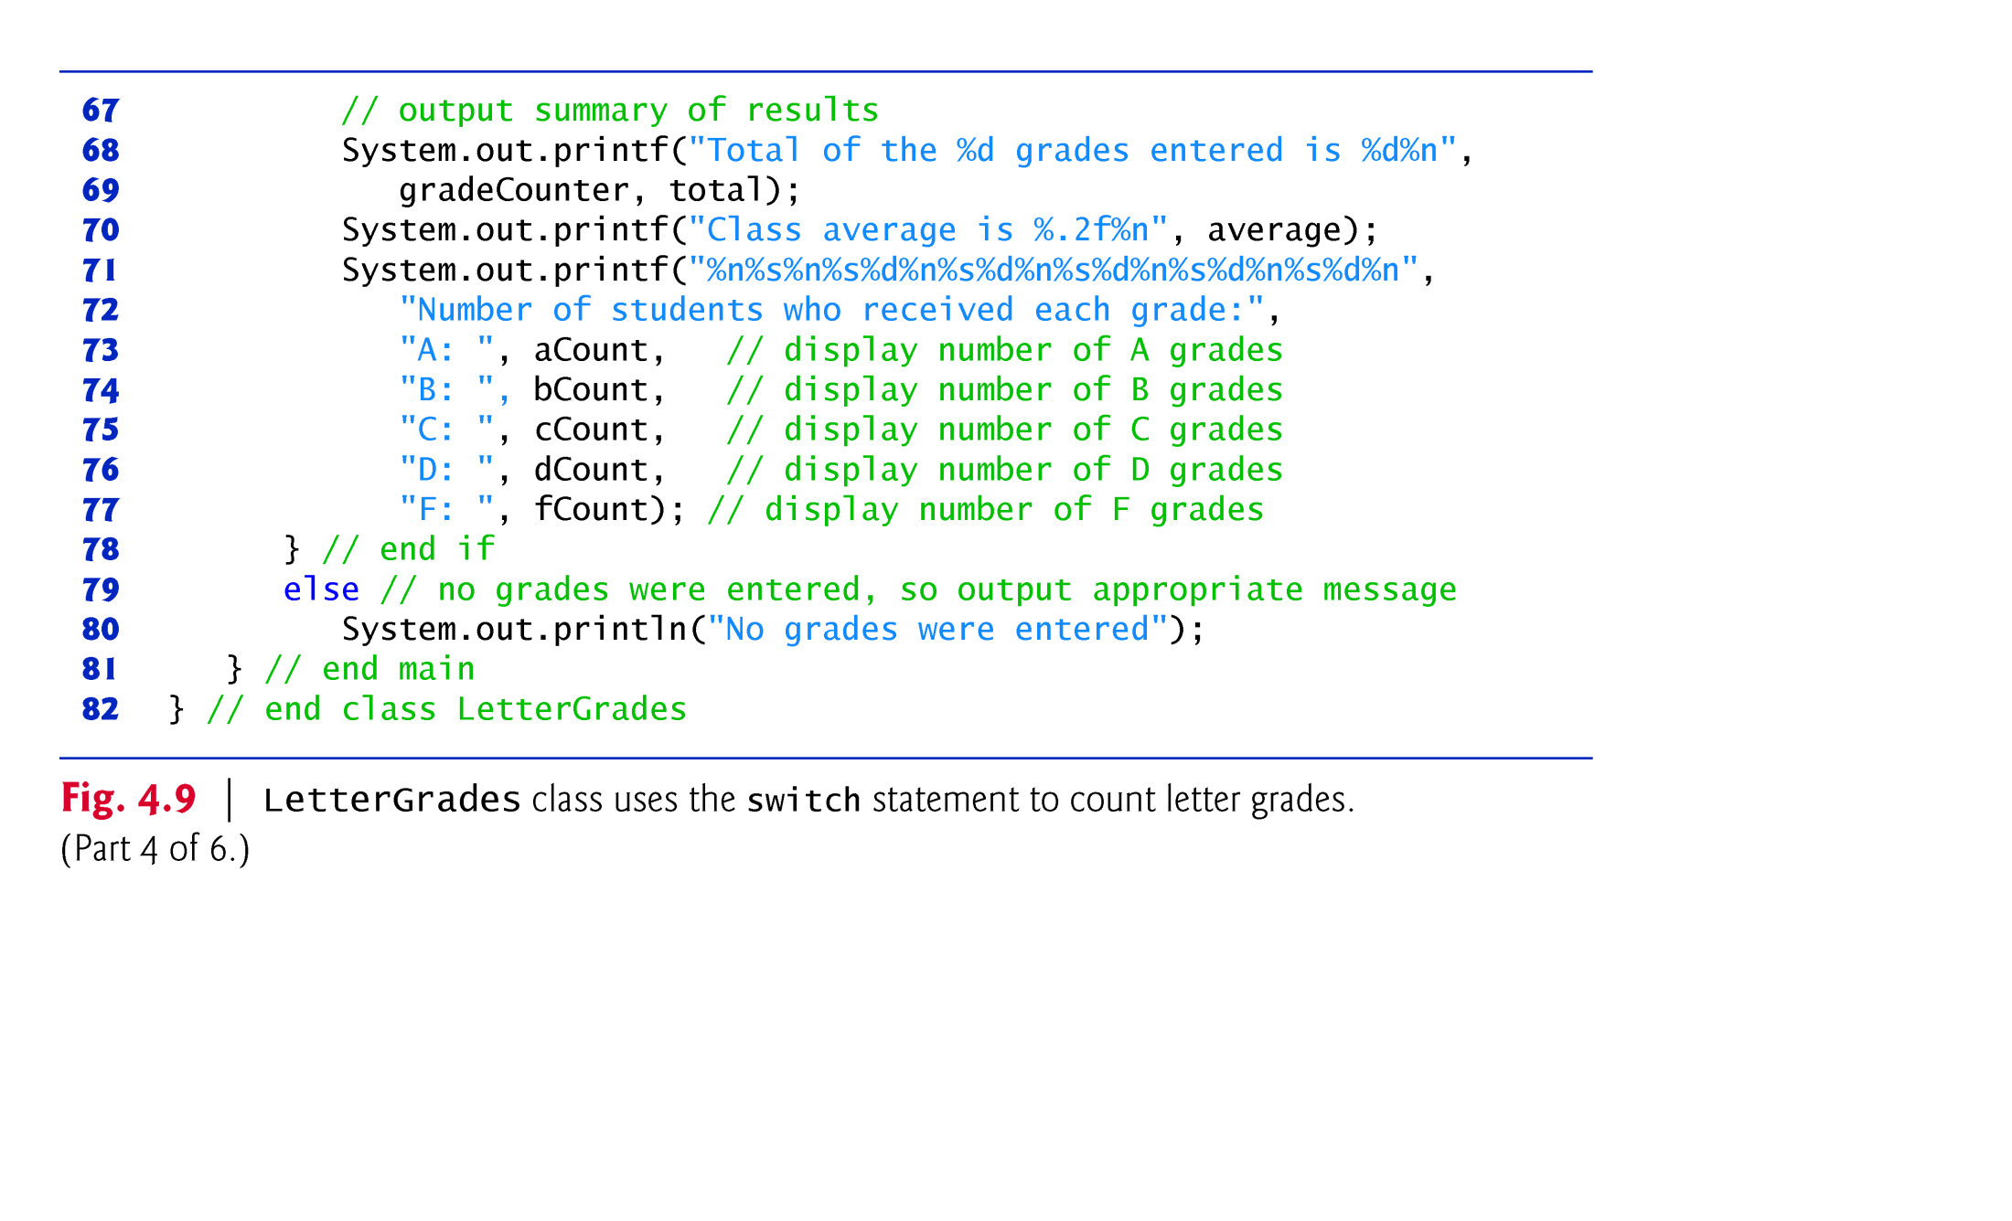
System.out.print(“Enter a grade in the range 0-100:”);
System.out.println(“Your grade is: A”);
System.out.println(“Your grade is: B”);
System.out.println(“Your grade is: C”);
System.out.println(“Your grade is: D”);
System.out.println(“Your grade is: F”);

Slide 35
4.6 switch Multiple-Selection Statement (Cont.)
The switch statement consists of a block that contains a sequence of case labels and an optional default case.
The program evaluates the controlling expression in the parentheses following keyword switch.
The program compares this expression’s value (which must evaluate to an integral value of type byte, char, short or int, or to a String) with each case label.
If a match occurs, the program executes that case’s statements.
The break statement causes program control to proceed with the first statement after the switch.

Slide 36

4.6 switch Multiple-Selection Statement (Cont.)
switch does not provide a mechanism for testing ranges of values—every value must be listed in a separate case label.
switch differs from other control statements in that it does not require braces around multiple statements in a case.
Without break, the statements for a matching case and subsequent cases execute until a break or the end of the switch is encountered. This is called “falling through.”
If no match occurs between the controlling expression’s value and a case label, the default case executes.
If no match occurs and there is no default case, program control simply continues with the first statement after the switch.

Slide 37

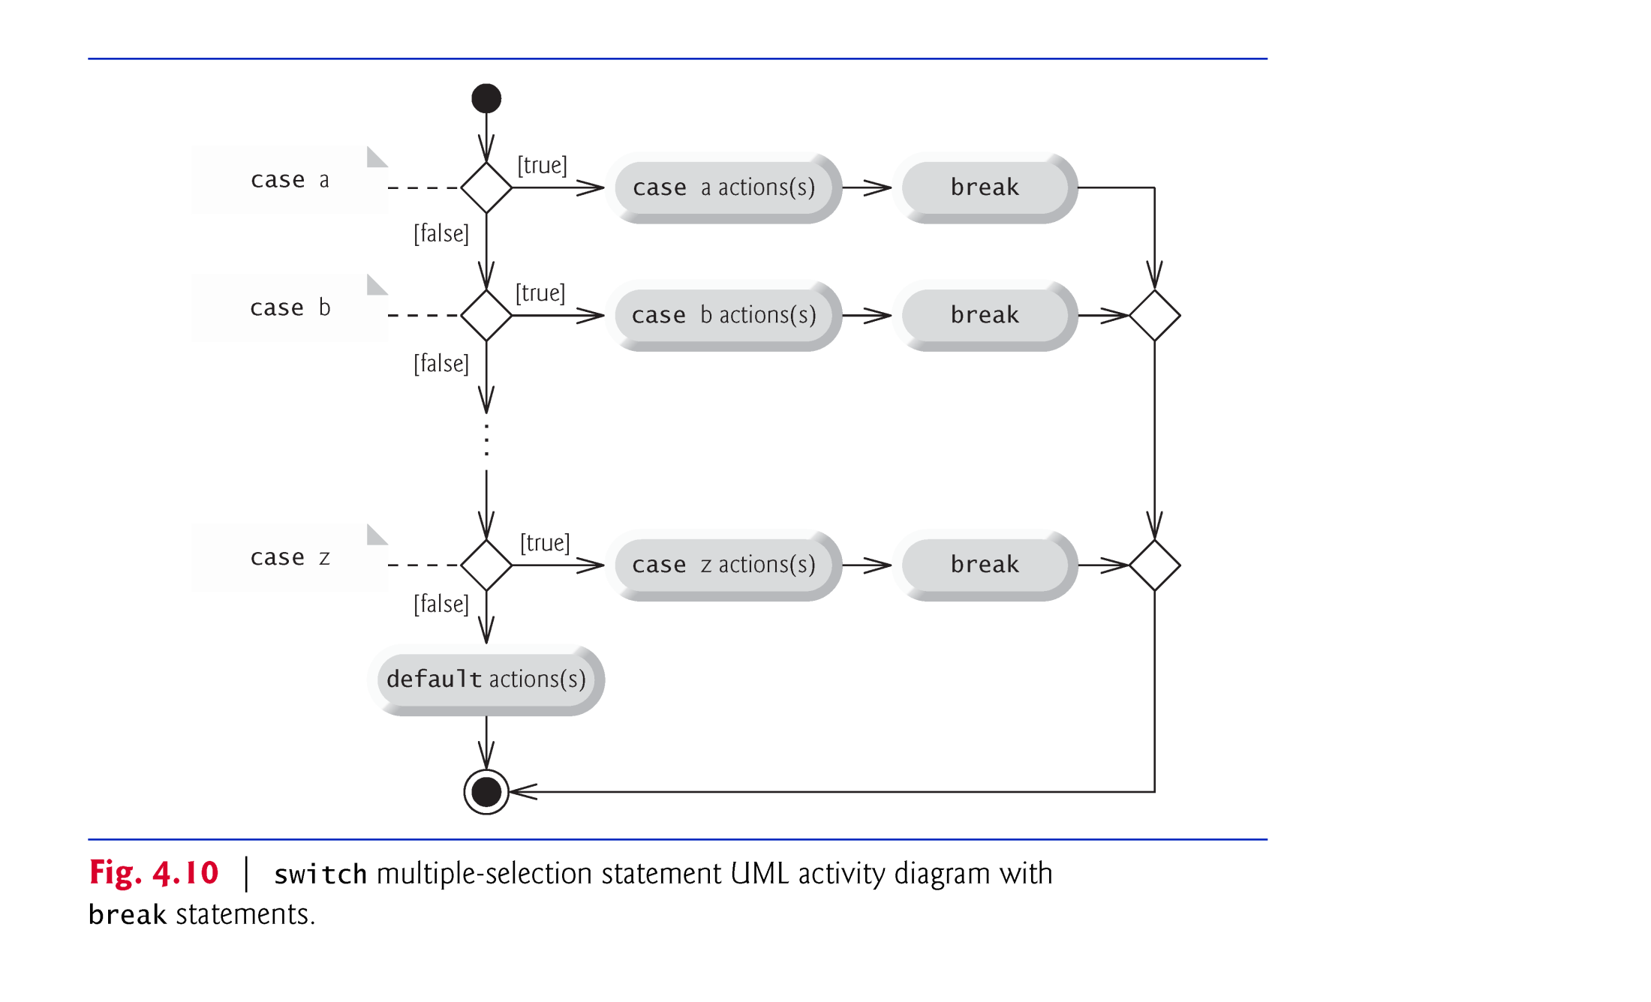

Slide 38
4.6 switch Multiple-Selection Statement (Cont.)
In addition, you can use character constants—specific characters in single quotes, such as 'A', '7' or '$'—which represent the integer values of characters and enum constants.
The expression in each case can also be a constant variable—a variable that contains a value which does not change for the entire program. Such a variable is declared with keyword final.
Java has a feature called enum types. enum type constants can also be used in case labels.

Slide 39
4.8 Logical Operators
Java’s logical operators enable you to form more complex conditions by combining simple conditions.
The logical operators are we are interesting in are:
&& (conditional AND)
|| (conditional OR)
! (logical NOT).
Other logical operator exist in Java:
& (boolean logical AND)
| (boolean logical inclusive OR)
^ (boolean logical exclusive OR)
[Note: The &, | and ^ operators are also bitwise operators when they are applied to integral operands.]

Slide 40
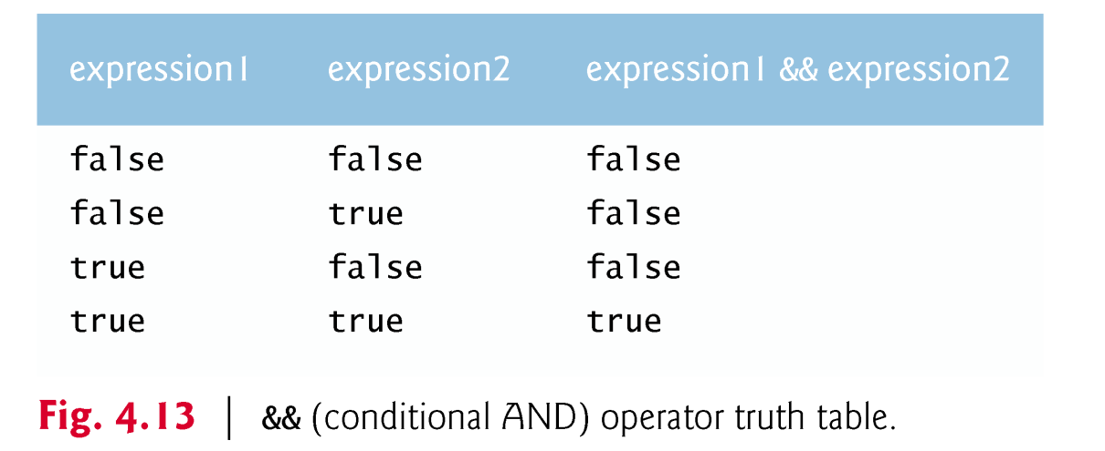
4.8 Logical Operators (Cont.)
The && (conditional AND) operator ensures that two conditions are both true before choosing a certain path of execution.
Java evaluates to false or true all expressions that include relational operators, equality operators or logical operators.

Slide 41
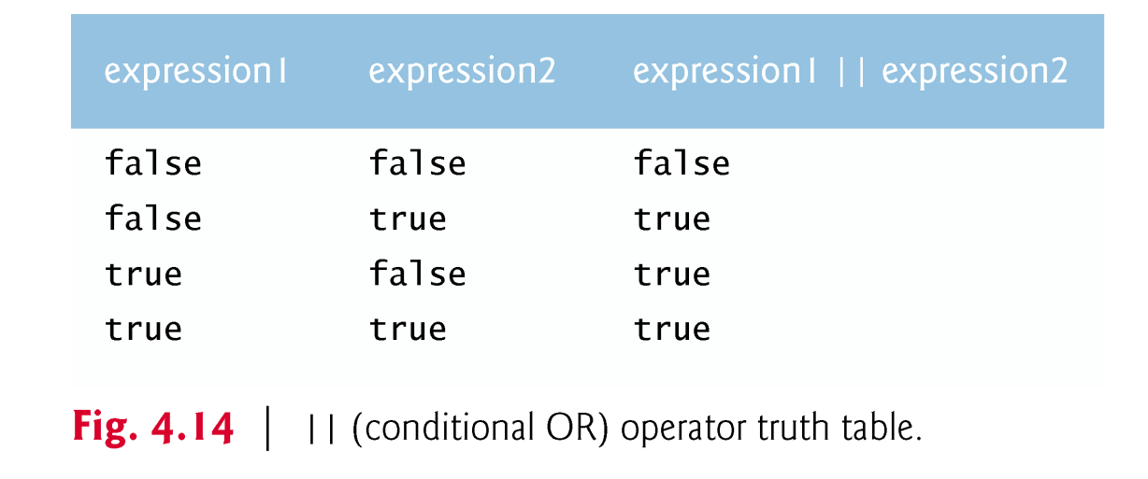
4.8 Logical Operators (Cont.)
The || (conditional OR) operator ensures that either or both of two conditions are true before choosing a certain path of execution.
Operator && has a higher precedence than operator ||.
Both operators associate from left to right.

Slide 42
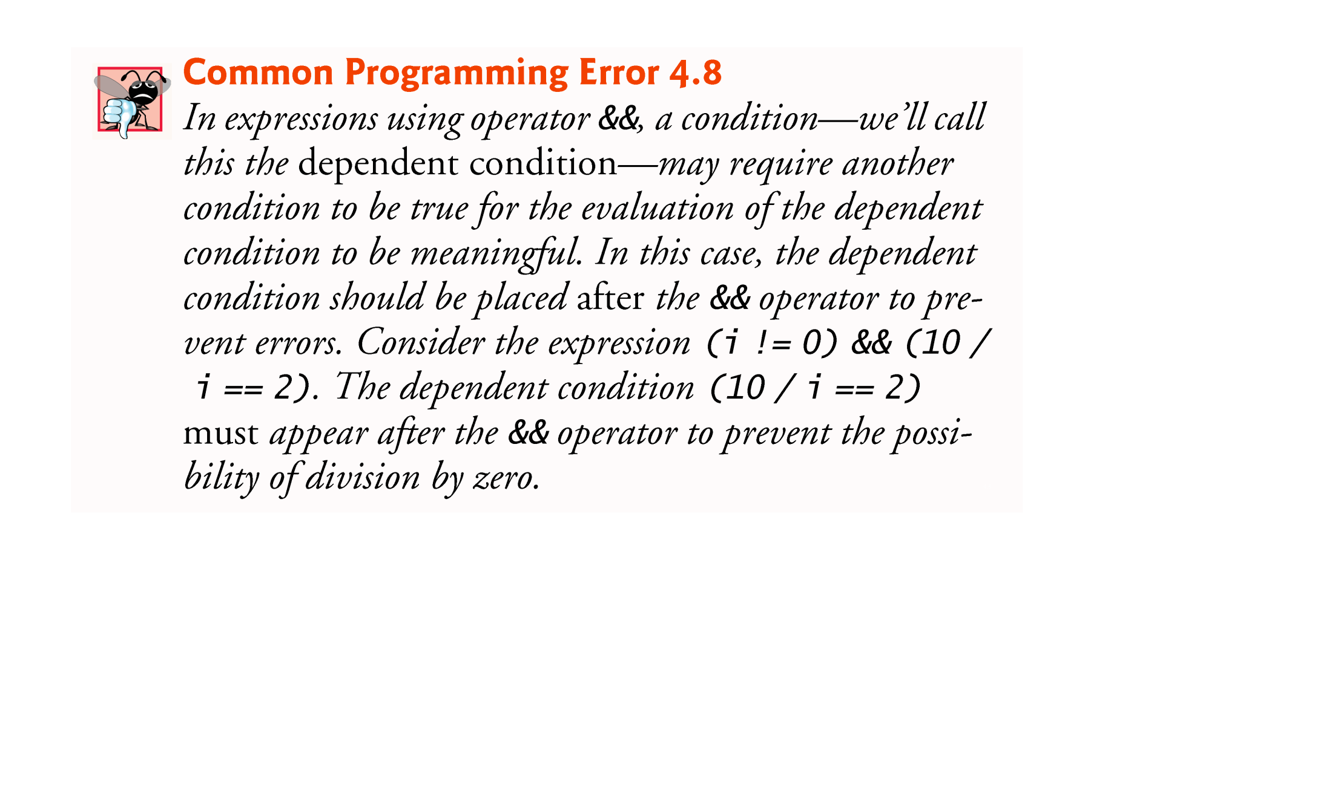

Slide 43
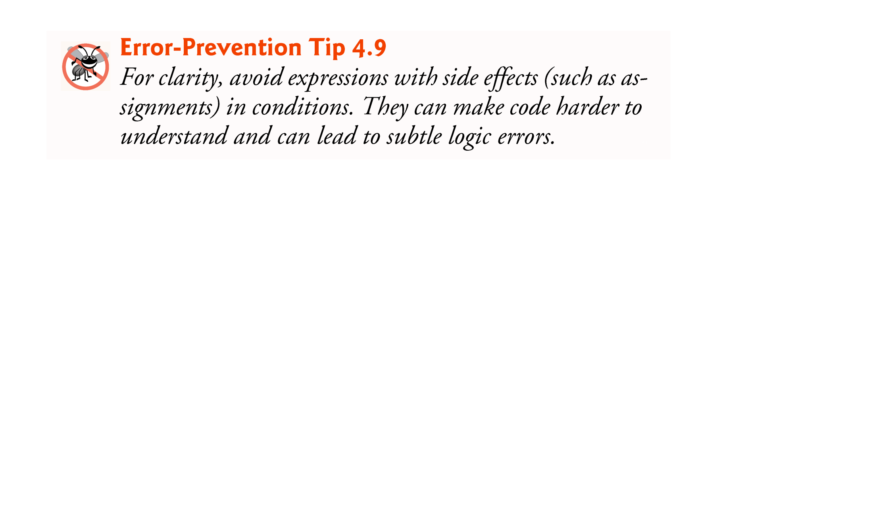
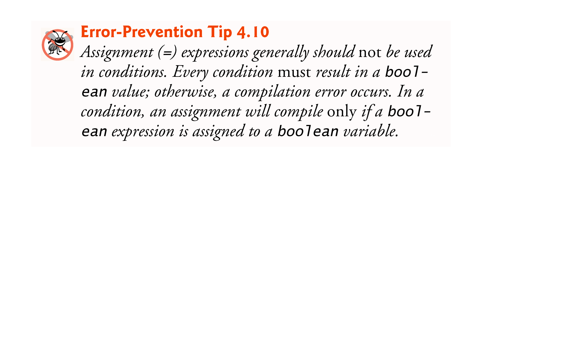

Slide 44
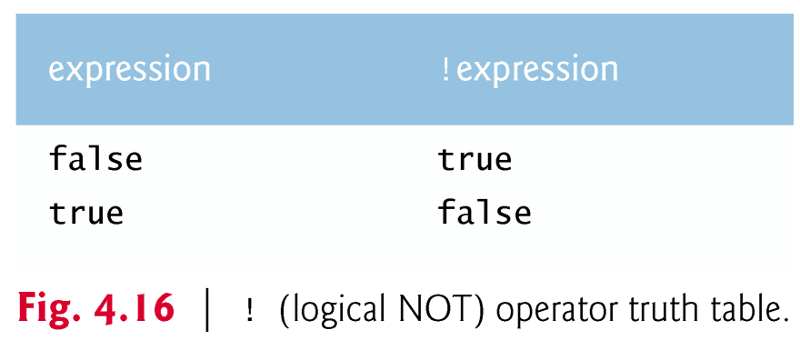
4.8 Logical Operators (Cont.)
The ! (logical NOT, also called logical negation or logical complement) operator “reverses” the meaning of a condition.
The logical negation operator is a unary operator that has only one condition as an operand.
The logical negation operator is placed before a condition to choose a path of execution if the original condition (without the logical negation operator) is false.
In most cases, you can avoid using logical negation by expressing the condition differently with an appropriate relational or equality operator.

Slide 45
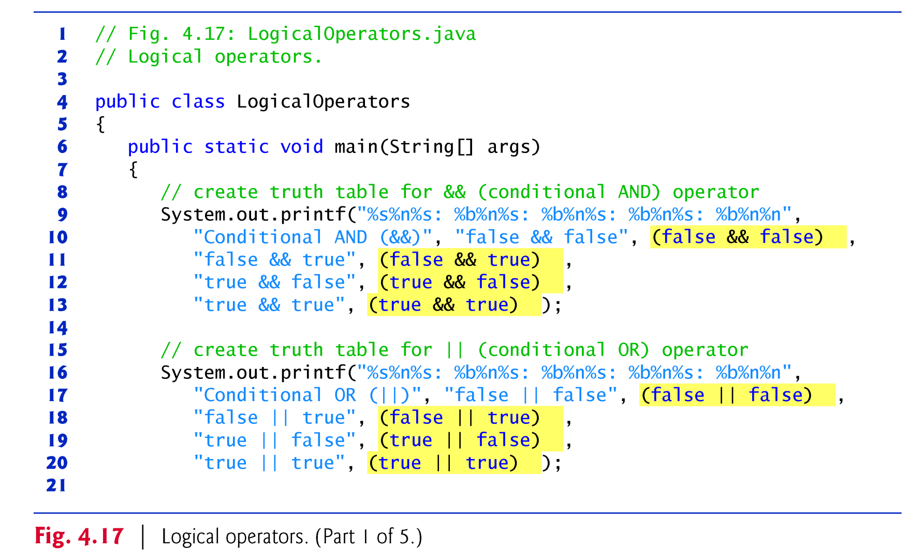
4.8 Logical Operators (Cont.)
The %b format specifier displays the word “true” or the word “false” based on a boolean expression’s value.

Slide 46
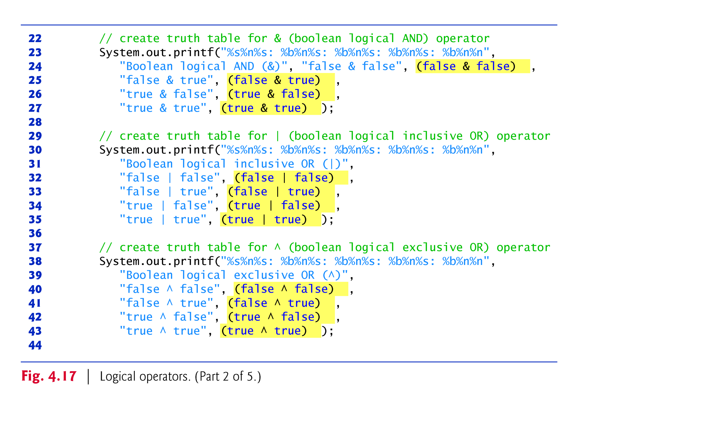

Slide 47
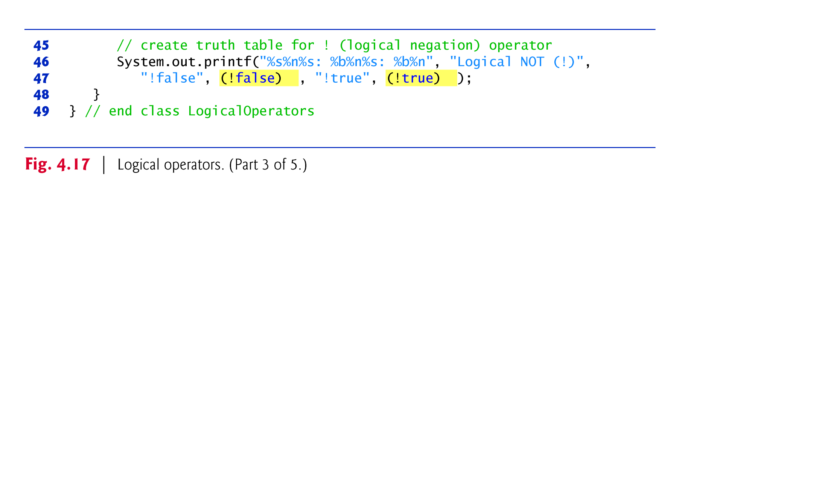

Slide 48
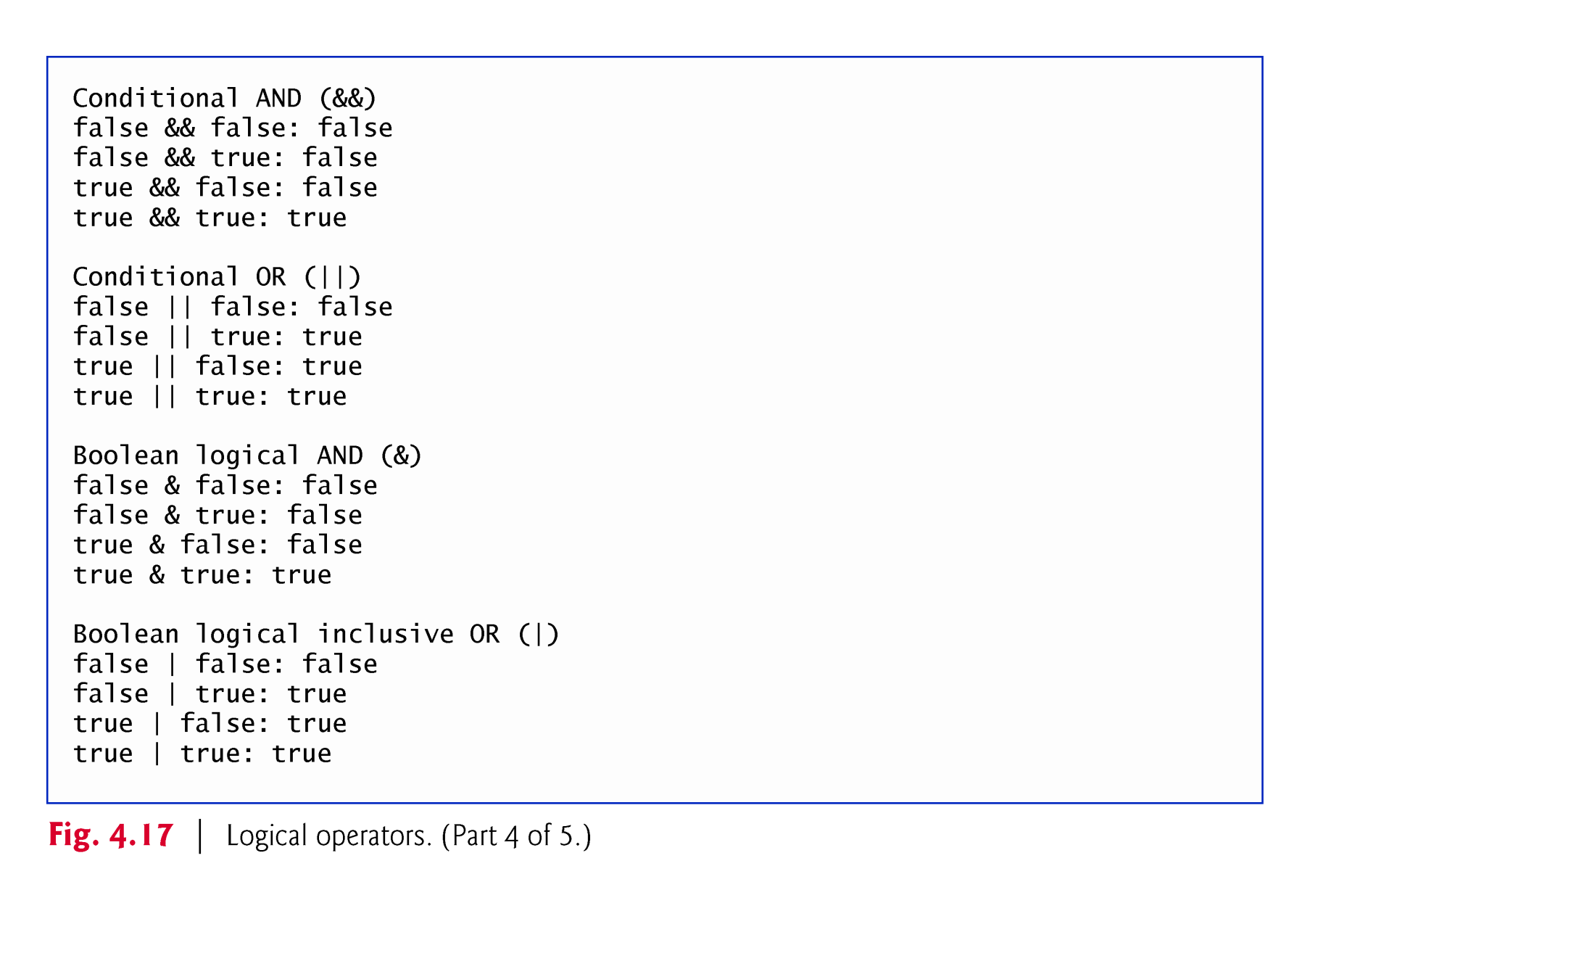

Slide 49
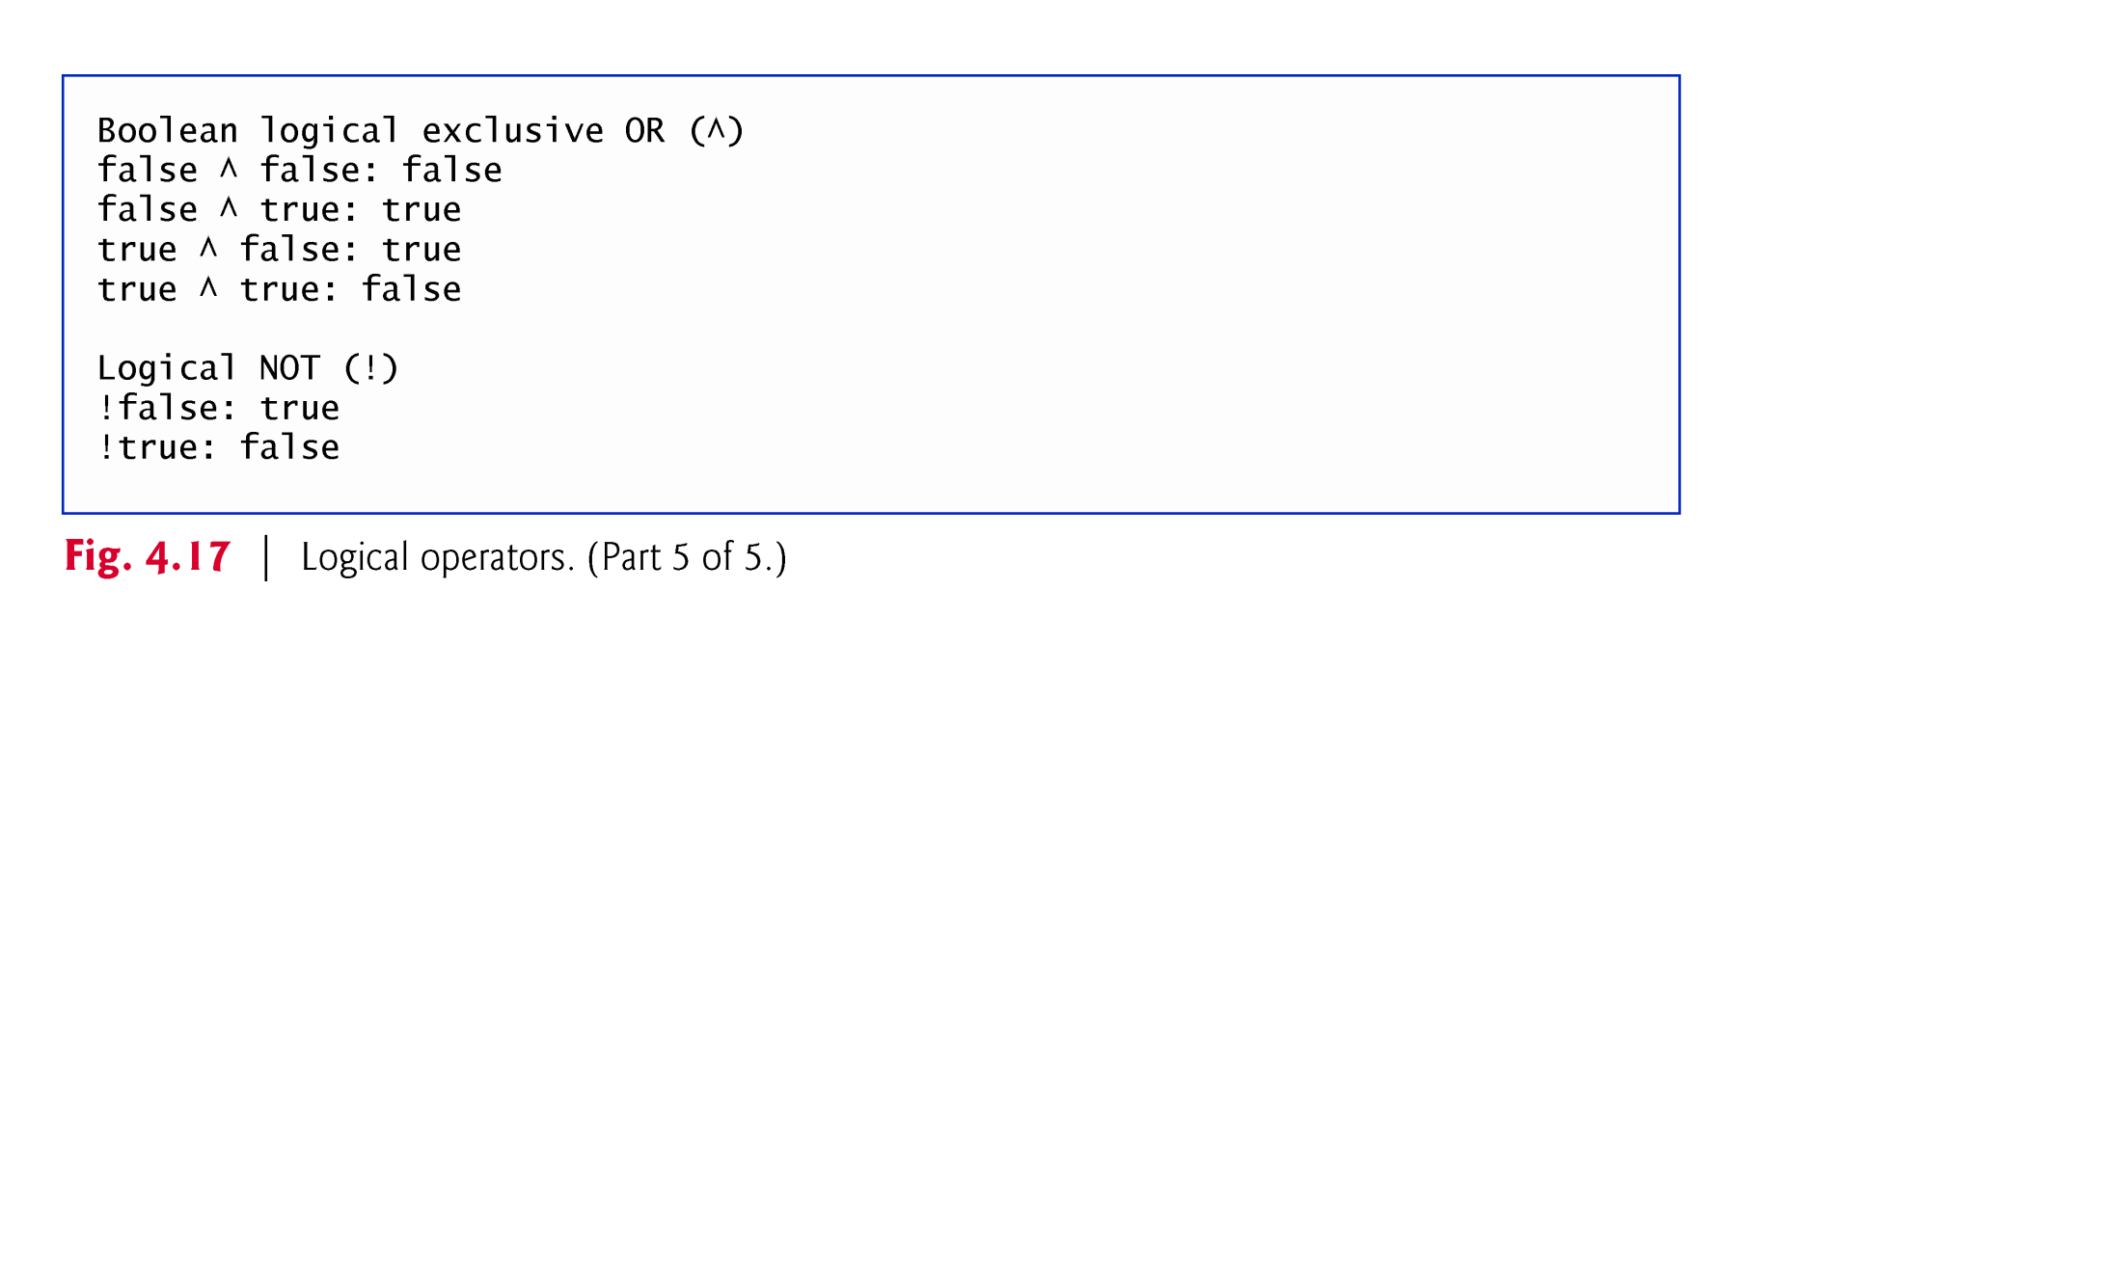

Slide 50
